Slide 1
Winter Term 22-23 Probabilistic Models - Modeling, Learning and Analysis Intro do Reinforcement Learning
Prof. Dr. Holger Giese (holger.giese@hpi.uni-potsdam.de)
Christian Medeiros Adriano (christian.adriano@hpi.de) - “Chris”

Slide 2
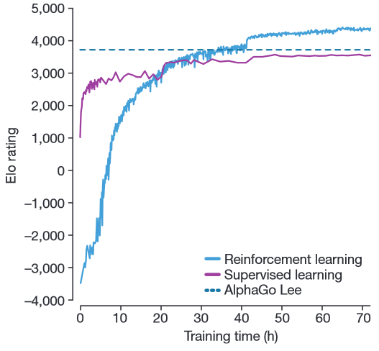
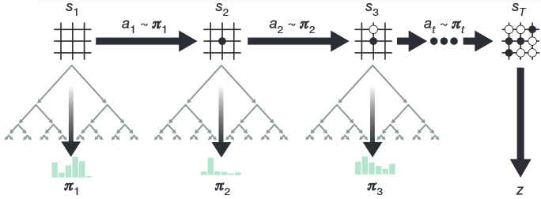
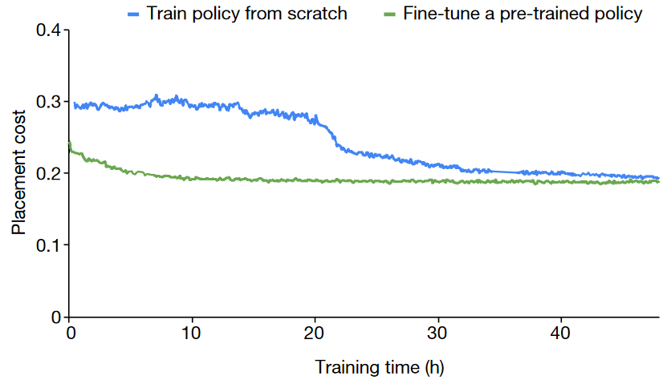
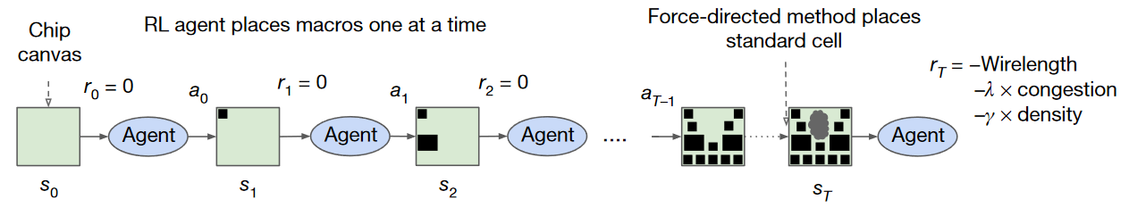
Progress of Techniques– Reinforcement Learning
Alpha Go-Zero learned to win without supervision, only by self-play [DeepMind 2017]
RL agent designed optimal layouts for TPU chip circuit [Google 2021]
Notes:
Let’s look deeper into the progress of these techniques, in particular reinforcement learning, where an intelligent agent makes decisions on how to learn a model of a complex environment as means to control it. Alpha Go-Zero learned to win the famous game of Go without supervision. Instead, it learned by playing against previous versions of itself. Besides that, as the blue and purple curves on the right show, the self-play approach achieved higher performance than the previous version of the Alpha-Go. If you recall, the one that defeated the world-champion Another recent progress. This year Google announced that a reinforcement learning agent was able to design optimal circuit layouts for its TensorFlow chip. A feat that was still beyond the capacity of automated tools.

Slide 3
Context: The Progress of Multi-Agent Reinforcement Learning
AlphaStar was rated at Grandmaster level for all three StarCraft races and above 99.8% of officially ranked human players [Deepmind 2019]
Three pools of agents, each initialized by supervised learning, were subsequently trained with reinforcement learning. As they trained, the agents intermittently added copies of themselves and played against previous version.
[DeepMind 2019] “Grandmaster level in StarCraft II using multi-agent reinforcement learning”. Nature 57
OpenAI Five became the first AI system to defeat the world champions at a sports game [OpenAI 2019]
Self-play RL can achieve superhuman performance on a challenging multi-agent task, e.g., extremely long-temporal dependencies.
[OpenAI 2019] "Dota 2 with large scale deep reinforcement learning." arXiv:1912.06680.
Notes:
Let's start with some context on the progress of multi-agent reinforcement learning. AlphaStar was rated at Grandmaster level for all three StarCraft races and above 99.8% of the officially ranked human players. Three pools of agents, each initialized by supervised learning, were then subsequently trained with reinforcement learning. The magic here was that during training, these agents added copies of themselves and played against previous versions. In another recent progress, OpenAI Five became the first AI system to defeat world champions at a sports game. They also relied on self-play to achieve super-human performance on a challenging multi-agent task with long temporal dependencies.

Slide 4
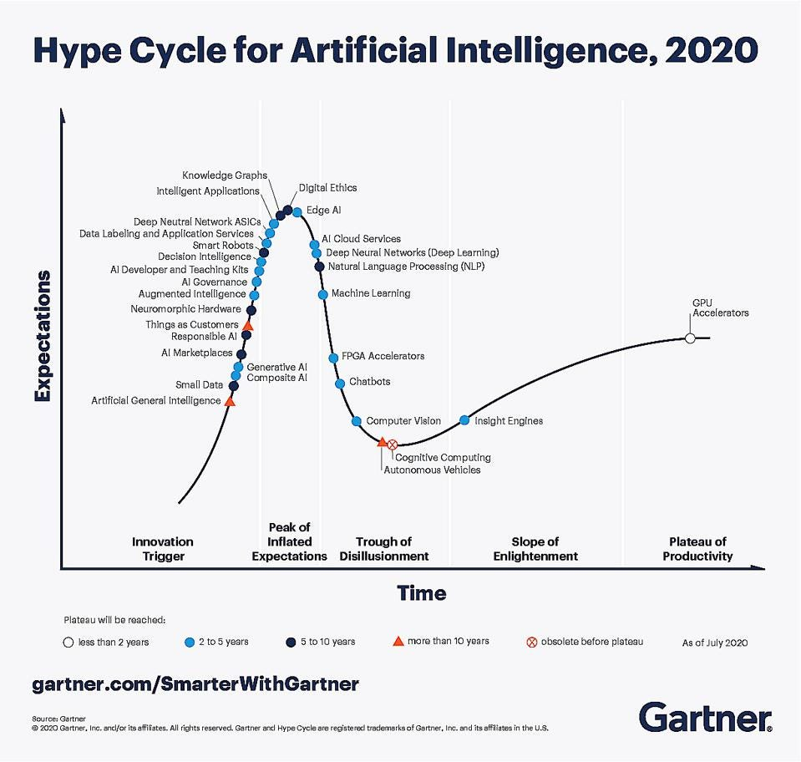
However AI systems are not being deployed
55% of companies surveyed haven't deployed a machine learning model [Algorithmia 2020]
72% that began AI pilots before 2019 haven’t deployed a single system yet [Capgemini 2020]
Why? Current models cannot adapt to more complex and evolving realities - adversarial environment
[Gartner 2020]
Problem? Lack of Robustness in AI Systems
[Jordan 2019], [D’Amour et al. 2020]
Notes:
-However, industry surveys report that from 55 to 72% of companies are not being able to deploy AI systems.
-Why? Because these systems cannot adapt to more complex and evolving realities, in other words, adversarial environments.
-The inability to adapt is a problem of lack of robustness in these AI Systems.

Slide 5
The Nature of the Problem- Structure vs Frequency
Degree of structure
Physical laws
traffic
protein folding
circuit design
1
Artificial laws
games
simulators
software systems
2
Strong
(well-constrained)
[Google 2021]
[DeepMind 2017]
4
Human laws
human-in-the loop
image & text interfaces
3
Adversarial laws
distribution shifts
concept drifts
latent factors
Medium
(under-specified)
[!]
[Gao et al. 2021]
Sparse
(causal associations)
High
(accidental associations)
Frequency of events
Notes:
Before we search for solutions, let’s try to understand the nature of this problem. It has two dimensions: how structured the laws are, for instance, well-constrained as in quadrants 1 and 2, which correspond to the physical laws as in traffic and the artificial laws as in games. The second dimension is the frequency of the events, like high frequency as in quadrants 2 and 3 or sparse as in 1 and 4. *Many solutions cover quadrants 1, 2, and 3. However, quadrant 4 is under-explored, because adversarial laws are much more challenging. That’s why in the last years, our group has been exploring exactly the quadrant 4.

Slide 6
Reinforcement Learning
Notes:
https://en.wikipedia.org/wiki/Transduction_(machine_learning)

Slide 7
Topics
Review of MDP Learning Algorithms
Concepts
Model-based algorithms (Value or Policy iteration)
Model-free algorithms (Sarsa and Q-Learning)
Model-based architectures
Dyna-Q
POMDP / Hidden-Markov Models

Slide 8
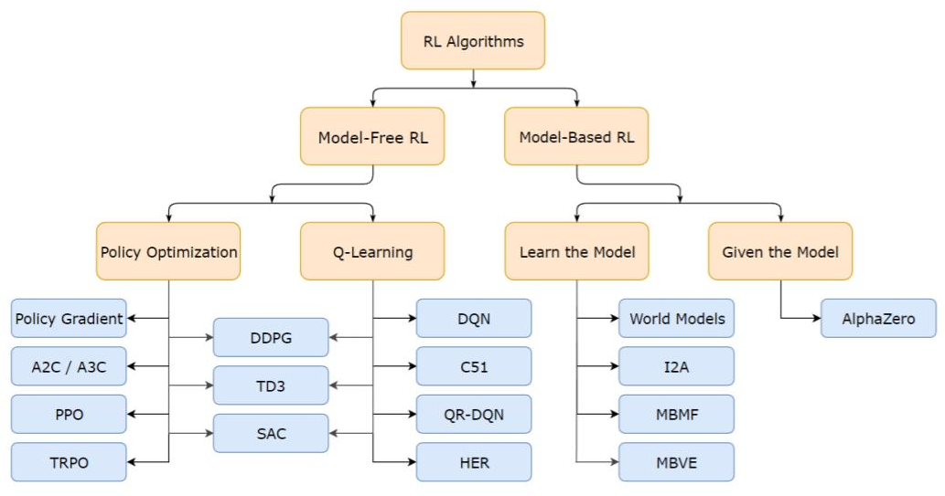
Brief Taxonomy of RL Methods

Slide 9
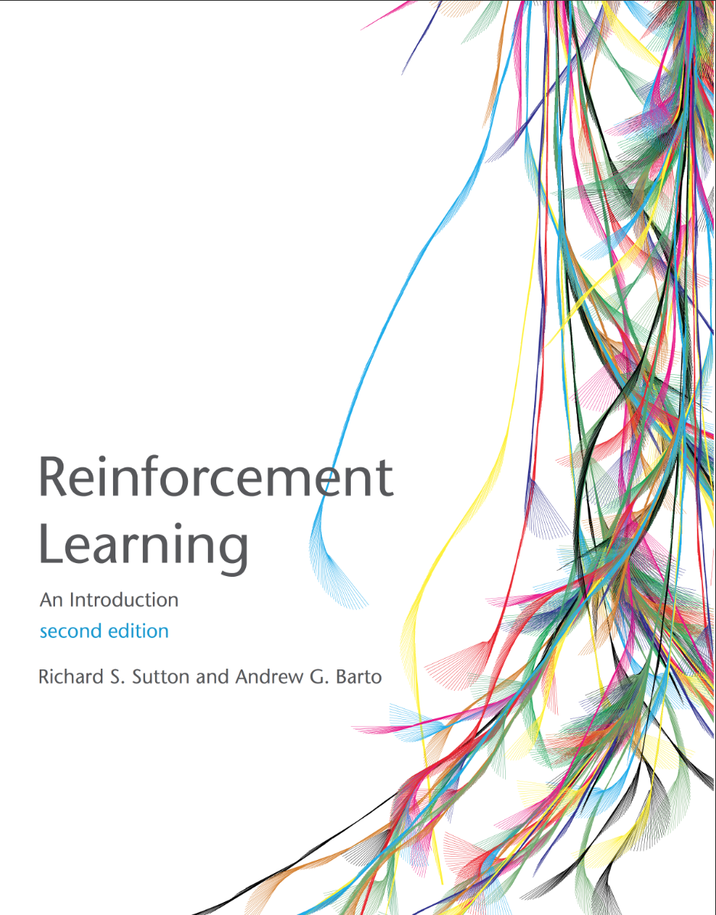
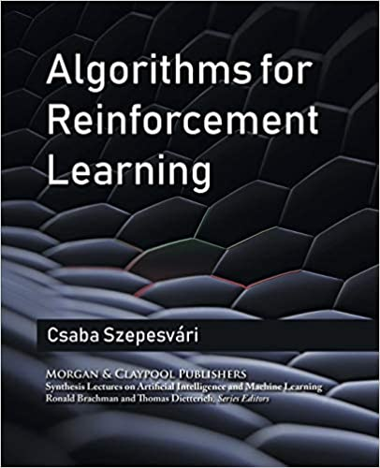

Resources used
Sutton, R. S., & Barto, A. G. (2015). Reinforcement learning: An introduction. MIT press. http://richsutton.com
Csaba Szepesvári (2010). Algorithms for reinforcement learning Morgan and Claypool. https://sites.ualberta.ca/~szepesva/rlbook.html
Lectures at UCL from DeepMind Research Scientists:
David Silver, 2015, https://www.davidsilver.uk/wp-content/uploads/2020/03/MC-TD.pdf
Hado Van Hansselt, 2018 https://www.youtube.com/watch?v=nnxHlg-2WgA&list=PLqYmG7hTraZBKeNJ-JE_eyJHZ7XgBoAyb&index=4
https://www.deepmind.com/learning-resources/reinforcement-learning-lecture-series-2021
Notes:
https://www.microsoft.com/en-us/research/blog/exploring-the-fundamentals-of-multi-armed-bandits/

Slide 10
Basic concepts - Structure
Agent: external to the environment, take actions and has access to external states
Environment: constrains the agent, has hidden and visible states
State: visible information about the environment after an action was taken
Reward: value obtained after taking an action or being at a state
Action: taken by an agent, might cause a change in state
Goal: Maximize rewards by using an optimal policy
Policy: set of state action pairs
Markov property: we only need to know the current state to predict the next state

Slide 11
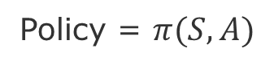
Agent and Environment Interaction
Action
Agent
Environment
State
Reward
Agent’s Goal: Maximize its reward
Our Goal: Discover a strategy that allows the agent to achieve its goal under various circumstances
Search, Estimate, Learn
Policy = $π(S,A)$
knowlege about the environment

Slide 12
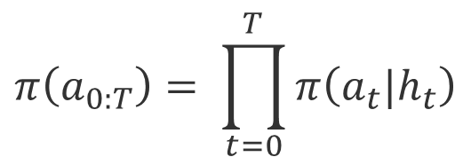
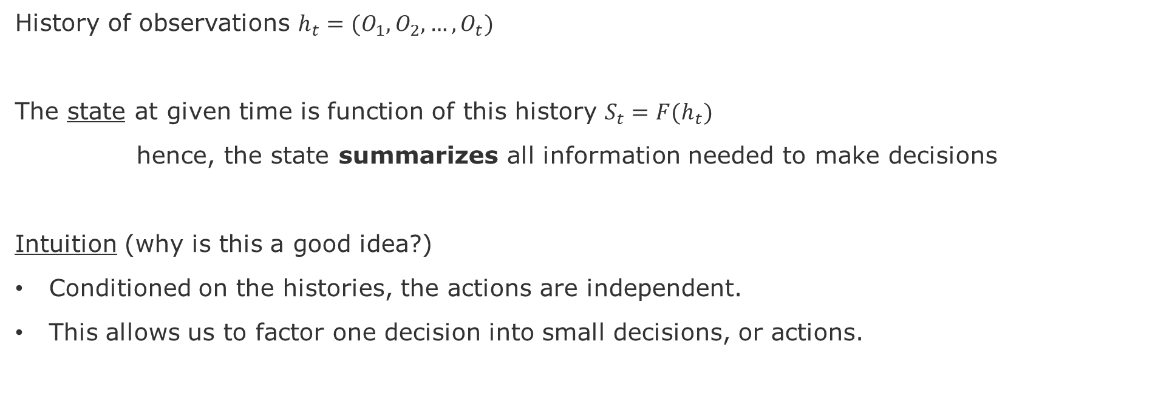
State
History of observations $h_{t}=(O_{1},O_{2}, …,O_{t})$
The state at given time is function of this history $S_{t}=F(h_{t})$
hence, the state summarizes all information needed to make decisions
Intuition (why is this a good idea?)
Conditioned on the histories, the actions are independent.
This allows us to factor one decision into small decisions, or actions.
$$π\left(a_{0:T}\right)= \prod_{t=0}^{T}{π\left(a_{t}|h_{t}\right)}$$

Slide 13
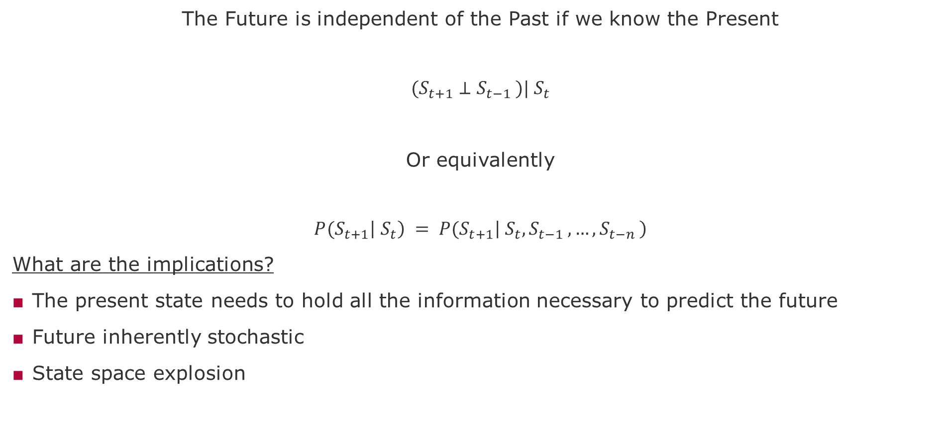
Markov Property
The Future is independent of the Past if we know the Present
$${(S}_{t+1} ⊥S_{t−1 })|{ S}_{t}$$
Or equivalently
$${P(S}_{t+1}\left|{ S}_{t}\right) = {P(S}_{t+1}\left|{ S}_{t},S_{t−1 },…,S_{t−n }\right)$$
What are the implications?
The present state needs to hold all the information necessary to predict the future
Future inherently stochastic
State space explosion

Slide 14
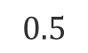
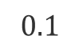
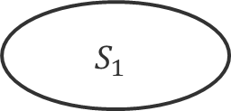
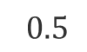
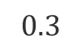
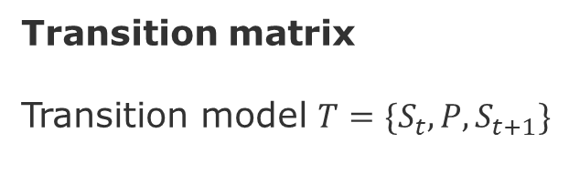
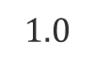
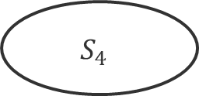
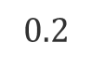

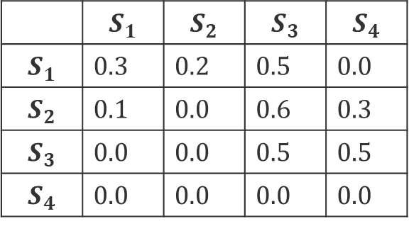
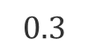

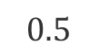
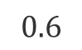
Markov Chain
MDP = Markov Chain + Actions
Transition matrix
Transition model ${T=\{S}_{t},P,S_{t+1}\}$
$$0.3$$
$$0.5$$
$$S_{1}$$
$$0.5$$
$$S_{3}$$
 | $$S_{1}$$ | $$S_{2}$$ | $$S_{3}$$ | $$S_{4}$$
$$S_{1}$$ | 0.3 | 0.2 | 0.5 | 0.0
$$S_{2}$$ | 0.1 | 0.0 | 0.6 | 0.3
$$S_{3}$$ | 0.0 | 0.0 | 0.5 | 0.5
$$S_{4}$$ | 0.0 | 0.0 | 0.0 | 0.0
$$0.2$$
$$0.1$$
$$0.6$$
$$0.5$$
$$S_{2}$$
$$0.3$$
$$S_{4}$$
$$1.0$$
End
Problems of learning and planning
Problems of prediction and control

Slide 15
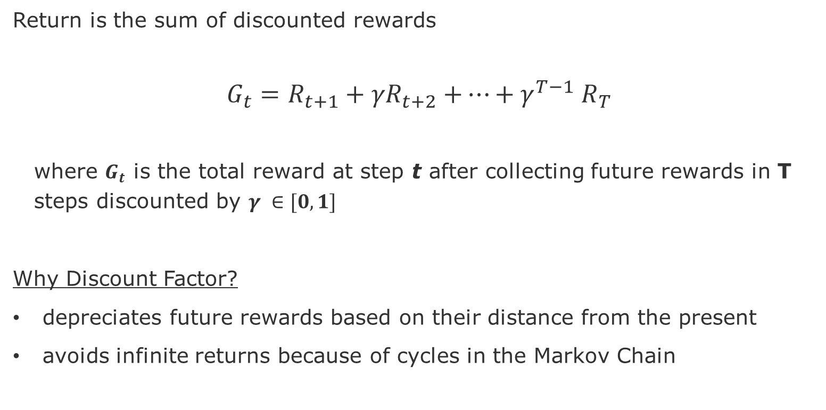
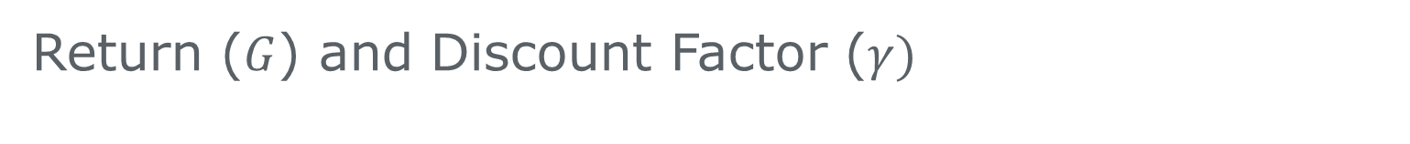
Return ($G$) and Discount Factor ($γ)$
Return is the sum of discounted rewards
$$G_{t}=R_{t+1}+{γR}_{t+2}{+…+γ}^{T−1}R_{T}$$
where $G_{t}$ is the total reward at step t after collecting future rewards in T steps discounted by $γ ∈[0,1]$
Why Discount Factor?
depreciates future rewards based on their distance from the present
avoids infinite returns because of cycles in the Markov Chain

Slide 16
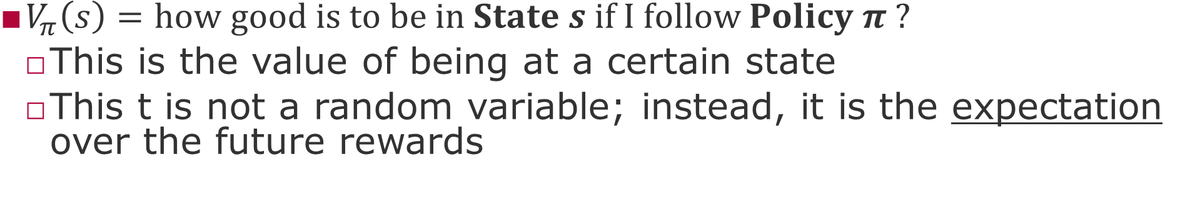
State Value Function
$V_{π}\left(s\right)=how good is to be in State s if I follow Policy π ?$
This is the value of being at a certain state
This t is not a random variable; instead, it is the expectation over the future rewards

Slide 17
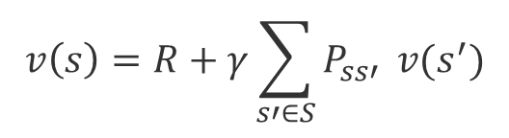
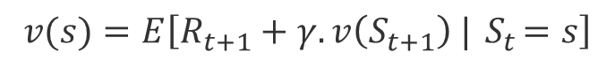
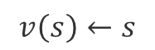
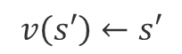
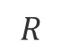
Bellman Equation
$$v(s)=E\left[R_{t+1}+γ.v\left(S_{t+1}\right) |{ S}_{t}=s\right]$$
$$v\left(s\right)←s$$
$$R$$
$$v\left(s′\right)←s′$$
One-Step Lookahead idea
$$v\left(s\right)=R+γ\sum_{s′∈S}{P_{ss′}} v(s^{′})$$

Slide 18
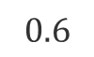
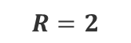
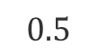
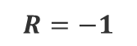
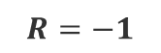
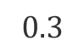
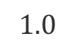
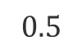


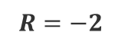

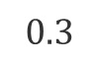

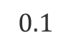
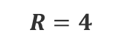
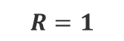
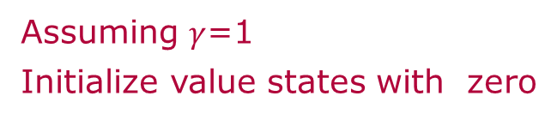

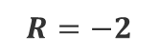
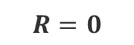
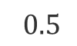





















Markov Reward Process (MRP)
$$0.3$$
$$R=−2$$
$$0.5$$
$$R=−2$$
$$0.3$$
$$R=−2$$
$$0.5$$
$$R=−2$$
$$S_{1}$$
$$0.5$$
$$S_{3}$$
$$S_{1}$$
$$0.5$$
0
$$R=−1$$
$$R=−1$$
$$0.2$$
$$0.1$$
$$0.6$$
$$0.5$$
$$R=4$$
$$0.2$$
$$0.1$$
$$0.6$$
$$0.5$$
$$R=4$$
$$R=−1$$
$$R=−1$$
$$R=1$$
$$R=−1$$
$$R=1$$
$$R=−1$$
$$S_{2}$$
$$0.3$$
$$S_{4}$$
$$1.0$$
$$S_{2}$$
$$0.3$$
20
$$1.0$$
End
End
$$R=2$$
$$R=2$$
$$R=0$$
$$R=0$$
Assuming $γ$=1
Initialize value states with zero
Value of $S_{3}$ = 4 + 20*0.5 +(-2 +0.5*0.0) =14

Slide 19



Bellman equation in matrix form
$$v=R+γPv$$
$$\left[\begin{matrix}v(1) \\ ⋮ \\ v(n)\end{matrix}\right]=\left[\begin{matrix}R_{1} \\ ⋮ \\ R_{n}\end{matrix}\right]+ γ\left[\begin{matrix}P_{11} & ⋯ & P_{1n} \\ ⋮ & ⋯ & ⋮ \\ P_{n1} & ⋯ & P_{nn}\end{matrix}\right]\left[\begin{matrix}v(1) \\ ⋮ \\ v(n)\end{matrix}\right]$$
$$v=(1− γPv)^{−1} R$$
Feasible for small number of states
Linear version of the Bellman Equation

Slide 20

Markov Decision Process (MDP)
MDP = Markov Chain + Actions
Actions allow us to have control over the decision-making process
Policy = distribution over actions given states $π\left(s,a\right)=P(A_{t}=a|$ $S_{t}=s)$
Implications to the model:
Transition for each action
Results of actions can be stochastic (non-deterministic)
Action Value Function
$$Q_{π}\left(s,a\right)=how good is to be in State s and to take Action a if I follow Policy π ?$$
i.e., $Q_{π}\left(s,a\right)$ is the expected return of being at a state and taking a certain action and following a certain policy

Slide 21
Bellman Optimatility Equation
How to find the best path in the MDP?
Bellman equation estimates V(s) by looking ahead of possible future trajectories in the state-space
Intuition
If we behave optimally for the first step and then also behave optimally for the next step, we will find the optimal solution for the MDP. However, note that to behave optimally I need to average over all possible paths that are opened by my first step.

Slide 22













Bellman Optimality Equations for MDPs
$$v^{∗}\left(s\right)←s$$
$$v^{∗}\left(s\right)←s$$
$$R$$
$$q\left(s,a\right)←s,a$$
$$R$$
$$q^{∗}\left(s,a\right)←s,a$$
$$R$$
$$q^{∗}\left(s,a\right)←s,a$$
$$v^{∗}\left(s′\right)←s′$$
$$v^{∗}\left(s′\right)←s′$$
$$q^{∗}\left(s,a\right)=R_{s}^{a}+γ\sum_{s′∈S}{P_{ss′}^{a}}v^{∗}\left(s′\right)$$
$$v^{∗}\left(s\right)=\max_{a}{q^{∗}\left(s,a\right)}$$
$$v^{∗}\left(s\right)=\max_{a}\left({ R}_{s}^{a}+γ\sum_{s′∈S}{P_{ss′}^{a}}v^{∗}\left(s′\right)\right)$$
The value function of a state is the maximum that I can get after taking an action
The optimal value is the expected return of the multiple states that we can end up after taking action a

Slide 23















Episodes
$$A_{1.1}$$
$$A_{3.3}$$
Episode | Transitions | Σ Reward
1 | $$\left\{S_{1},A_{1.3},S_{3}\right\},\left\{S_{3},A_{3.3},S_{3}\right\}\left\{S_{3},A_{3.4},S_{4}\right\}$$ | 90
2 | $$\left\{S_{1},A_{1.2},S_{2}\right\},\left\{S_{2},A_{2.3},S_{3}\right\}\left\{S_{3},A_{3.4},S_{4}\right\}$$ | 110
3 | $$\left\{S_{1},A_{1.2},S_{2}\right\},\left\{S_{2},A_{2.3},S_{4}\right\}$$ | 60
4 | $$\left\{S_{2},A_{2.1},S_{1}\right\},\left\{S_{1},A_{1.3},S_{3}\right\}\left\{S_{3},A_{3.4},S_{4}\right\}$$ | 120
5 | $$\left\{S_{3},A_{3.3},S_{3}\right\}\left\{S_{3},A_{3.4},S_{4}\right\}$$ | 40
6 | $$\left\{S_{2},A_{2.3},S_{3}\right\},\left\{S_{3},A_{3.3},S_{3}\right\}\left\{S_{3},A_{3.4},S_{4}\right\}$$ | 80
7 | $$\left\{S_{2},A_{2.4},S_{4}\right\}$$ | 40
$$S_{1}$$
$$A_{1.3}$$
$$S_{3}$$
$$0.6$$
$$A_{1.2}$$
$$A_{2.1}$$
$$A_{3.4}$$
$$A_{2.3}$$
$$0.4$$
$$S_{2}$$
$$S_{4}$$
What can we infer from these episodes?
We can infer the ${R(\{S}_{1},A_{1.2},S_{2}\}$) = 60
We do not need to know all transitions
But we are not 100% sure because transitions are not deterministic

Slide 24
Model-Based Algorithms
Notes:
https://en.wikipedia.org/wiki/Transduction_(machine_learning)

Slide 25

Prediction versus Control Problems
Prediction
Goal: How much reward I am going to obtain from this MDP?
Input: An MDP (S, A, P, R, γ) and Policy ϖ
Output: Value Function $V_{π}\left(s\right)$
Control
Goal: Among all possible policies, what is the best policy for this MDP?
Input: An MDP (S, A, P, R, γ)
Output: an optimal Value Function $V_{π}^{∗}\left(s\right)$, which corresponds to an optimal policy ϖ*
Control
For-loop:
Prediction

Slide 26









Policy Evaluation and Policy Iteration
$$v_{k+1}\left(s\right)←s$$
$$a$$
$$R$$
$$v\left(s′\right)←s′$$
One step lookahead
$$v_{k+1}\left(s\right)=\sum_{a ∈A}{π\left(a | s\right)\left(R_{s}^{a}+γ\sum_{s′∈S}{P_{ss′}^{a}}v(s^{′})\right)}$$
current Reward
discounted future Reward
Evaluate:
$$v^{k+1}(s)=R^{π}+γP^{π}v^{k}$$
Improve:
$$π^{′}\left(s\right)=\max_{a ∈A}{q_{π}(s,a)}$$
Greedy!
Source: Silver, 2015, https://www.davidsilver.uk/wp-content/uploads/2020/03/DP.pdf

Slide 27









Value Iteration
$$v_{k+1}\left(s\right)←s$$
Algorithm:
For 1+k iteration:
For all states in S:
Update $v^{k+1}\left(s\right)$ from $v^{k}$(s)
$$a$$
$$R$$
$$v\left(s′\right)←s′$$
$$v_{k+1}\left(s\right)=\max_{a ∈A}\left(R_{s}^{a}+γ\sum_{s′∈S}{P_{ss′}^{a}}v(s^{′})\right)$$
$$v^{k+1}\left(s\right)=\max_{a ∈A}\left(R^{a}+γP^{a}v^{k}\right)$$
Source: Silver, 2015, https://www.davidsilver.uk/wp-content/uploads/2020/03/DP.pdf

Slide 28
Model-Free Algorithms
Notes:
https://en.wikipedia.org/wiki/Transduction_(machine_learning)

Slide 29

Monte Carlo Policy Evaluation
Sample the rewards for each action across multiple Episodes
Similar to what we have seen in the Multi-Armed Bandits
Discounted Rewards for an episode ending at time T>t
$$G_{t}=R_{t+1}+γR_{t+2}+{γ_{ }^{2}R}_{t+3}+…+{γ_{ }^{T−t−1}R}_{T}$$
Value function is the Expected Return
$$V_{π}=E{[G}_{t} | S_{t}=s,π]$$
Caveat: Multiple episodes necessary to update the state value function under a policy $V_{π}\left(S\right)$

Slide 30

Incremental Mean
Source: Silver, 2015, https://www.davidsilver.uk/wp-content/uploads/2020/03/MC-TD.pdf

Slide 31


Incremental Monte Carlo Updates
Updates $V_{π}\left(S\right)$ after each episode
Increments visits $N\left(S_{t}\right)++$
Update $V_{π}\left(S\right)= V_{π}\left(S\right)+\frac{1}{N\left(S_{t}\right)}(G_{t} −V_{π}\left(S\right))$
We are essentially tracking a running average, in other words, we are forgetting older episodes. Rate of forgetting can be further parameterized with a learning factor alpha
$$V_{π}\left(S\right)= V_{π}\left(S\right)+α(G_{t} −V_{π}\left(S\right))$$
Advantages:
Non-stationary estimator
Memoryless algorithms
Caveats:
Requires complete episodes must terminate (reach terminal state)
High variance, low bias (because $G_{t}$ is an unbiased estimate of future rewards)

Slide 32



Temporal Difference Learning
Recalling Policy Iteration
$$v^{t+1}\left(s\right)=R^{π}+γP^{π}v^{t}$$
$$v_{t+1}\left(S_{t}\right)=E{[R}_{t+1 }+γv_{t}\left(S_{t+1}\right)| S_{t}=s,A_{t \sim }π{(s}_{t})]$$
Bootstrapping
Monte Carlo
TD Learning
TD-Error
Advantages:
Updates with partial episodes
Size of partial episode is parameterizable (lambda)
Caveat: High Bias, but less variance (because update depends on only one action)

Slide 33

Batch Learning = Limited Budget
The batch dataset has 8 episodes with the following (state, return) values
Episode | Data
1 | (A,0), (B,0)
2 | (B,1)
3 | (B,1)
4 | (B,1)
5 | (B,1)
6 | (B,1)
7 | (B,1)
8 | (B,0)
What are the value function estimates for A and B?
Monte Carlo:
(A) = 0/8 = 0,
V(B) = 6/8 = 0.75
Temporal Difference:
V(A) = R(A) + [R(B) + V(B) - V(A)] = 0.75
V(B) = 0.75

Slide 34


Temporal Difference (TD) vs Monte Carlo (MC)
source: page 125 [Sutton & Barto 2018]
Notes:
Left plot: TD learning approximate true value of the states (black line) after 100 steps.
Right plot:
RMSE – Root mean-squared error between the value function learned and the true value
function, averaged over the five states, then averaged over 100 runs.
Low step size in makes TD and MC error curves smoother, however it takes longer to drop. Both converge to the trur value, but MC is noisier (higher variance).
Larger step size makes TD approximate faster, but it stabilizes at a higher error level.

Slide 35

Summary of pros and cons
Monte Carlo
High Variance, Low Bias
Good Convergence properties (even with function approximation)
Not very sensitive to initial values
Simple to understand and use
More efficient in non-Markov environments, because it does not explore the Markov Property
TD
Low Variance, High Bias
TD(zero) converges to $v_{π}(s)$(not always with function approximation)
More sensitive to initial values
More efficient in Markov environments, because it does explore the Markov Property

Slide 36




Comparing the three models
Monte Carlo
Temporal Difference
Bootstrapping: updating = to estimate
MC does not bootstrap
DP and TD bootstrap
Sampling: updating = to sample an expectation
MC and TD sample
DP does not sample
Dynamic programming

Slide 37


Trade-off between TD(0) and MC = TD(lambda)
Which n-value is the best?
Alpha = Learning rate
Gamma = Discount rate

Slide 38

TD(λ) Which n value is the best?

Slide 39
Control Improving the policy to find optimal value-function
Notes:
https://en.wikipedia.org/wiki/Transduction_(machine_learning)

Slide 40


Generalized Policy Iteration
Convergence
ϖ* ==V*
Policy Evaluation:
What? estimates V^{ϖ}
How? Iterative policy evaluation
Policy Improvement:
What? generates a ϖ’ ≥ ϖ
How? Greedy policy improvement
Variations to these components:
Monte Carlo Evaluation
epsilon-Greedy (fixed exploration rate)
Monte Carlo GLIE (decaying exploratoin rate)
TD(0) and TD(lambda)
Notes:
We will vary these two components.

Slide 41



Monte Carlo Control
Solution part-1: use Q because it is based on state, action pairs
$$v^{k+1}\left(s\right)=\max_{a ∈A}\left(R^{a}+γP^{a}v^{k}\right)$$
No guarantee that will find the optimum
Control
for-loop:
Solution part-2: add randomness in the choice of action (e-Greedy)
Prediction

Slide 42

GLIE Monte Carlo Control
GLIE – Greedy in the Limit with Infinite in the limit Exploration
Decays epsilon, for instance ε
$ε=\frac{1}{k}$, where k is the episode count
All <state,action> pairs are explored indefinitely
$$\lim_{k→∞}N_{k}\left(s,a\right)= ∞$$
The policy ϖ converges to a greedy policy
$$\lim_{k→∞}{π_{k}\left(s,a\right)=I(a= \max_{a′}{q_{k}(s,a′)})}$$
Theorem shows that it also converges to the optimal value-function
$$\lim_{k→∞}{π_{k}\left(s,a\right)=I(a= \max_{a′}{q_{k}(s,a′)})}$$
Advantage: Converges to the optimal greedy policy
Caveat: Still expensive, even with partial episodes

Slide 43

On-Policy versus Off-Policy Control
On-Policy
Learn on the job
How? Learn about policy $π$ from experience sampled from $π$
Off-Policy
Look over someone else’s shoulder
How? Learn about policy $π$ from experience sampled from the environment

Slide 44





Sarsa: On-Policy TD Control
Advantage: Converges to the optimal greedy policy
Caveat: Still expensive, even with partial episodes

Slide 45

Q-Learning: off-policy TD Control
Choose among all possible actions

Slide 46
Comparing Sarsa and Q-Learning
Q-Learning does not follow any given policy to update the Q-value
However, Q-Learning still follows a “behavioral” policy in order to determine which state-action pairs to visit

Slide 47

Trade-off between Sarsa and Q-Learning
Gridworld example from [Sutton & Barto 2018] page 132.
Goal: is to go from S to G avoiding the Cliff.

Slide 48


N-Step Sarsa TD(λ)

Slide 49
Once more…Brief Taxonomy of RL Methods

Slide 50


DQN - Deep Q-Network [Mnih 2013]
Q-Table
State
Action
Grows too large for continuous state-spaces
Q-value
Q-function
State
Action
F
Q-value
Like Double-Q-Learning, DQN is initialized with arbitrary Q-values and explores the environment using the ε-greedy policy.
It updates its Q-value via dual actions:
a current action with a current Q-value
a target action with a target Q-value
Q-network
State
Action
Q-value
Mnih, V., Kavukcuoglu, K., Silver, D., Graves, A., Antonoglou, I., Wierstra, D., & Riedmiller, M. (2013). Playing atari with deep reinforcement learning. arXiv preprint arXiv:1312.5602.

Slide 51
DQN - Components [Mnih 2013]
Experience Replay
Replay Buffer
Environment
Actual network
Target network
There is no restriction on the neural network architecture itself. Therefore, one could use:
RNN for Text
CNN for Images
LSTM for regular data
GNN for graph data?
Which ever choice of network architecture, both actual and target networks should have the same architecture
Mnih, V., Kavukcuoglu, K., Silver, D., Graves, A., Antonoglou, I., Wierstra, D., & Riedmiller, M. (2013). Playing atari with deep reinforcement learning. arXiv preprint arXiv:1312.5602.

Slide 52
DQN – Why experience replay?
trained it with single samples, each sample and the corresponding gradients would have too much variance, and the network weights would never converge.
Why few actions in sequence one after the other and then feed that data as a batch to the Q Network? That should help to smoothen out the noise and result in more stable training, shouldn’t it?
Deep Learning best practice requires selecting a batch of samples after shuffling to ensure enough diversity in the training so the network can generalize
Sequential actions are strongly correlated. Replay buffer allows to make the data i.i.d. which is necessary for training a neural net.
Why i.i.d. matters?
Identically Distributed allows to build a prediction model of Y given a set of features, e.g., P(Yi|Xi)
Independent guarantees the rows in the data present new information to train the model and sufficient (but not necessary condition) for:
For consistency and providing error bounds
For random sampling techniques
Notes:
https://stats.stackexchange.com/questions/213464/on-the-importance-of-the-i-i-d-assumption-in-statistical-learning

Slide 53
DQN – Why do we need two networks?
Because it is more stable
Q-learning is a temporal difference method that uses bootstrapping, i.e., the TD target is estimated with the same neural network that is being updated (instability!).
Solution: separate the target network from the behavior network (update at every step) The behavior network is updated at every step, but the target network has its parameter fixed and periodically copied from the behavior network.
Note that the target network doesn’t get trained, therefore, its weights remain stable for at least a short period.
After a parameterized number of time-steps, the learned weights from the Q Network are copied over to the Target Network.

Slide 54

DQN – Pseudo-code

Slide 55
DQN – Training Process
Experience replay collects training samples by interacting with the environment
Sample a random batch of data from the replay buffer
Predict Q-Values on
Target-Network
Every T steps, overwrite the Target-Network weight with the current Q-Network weights
Update Q-Network
Keep Target-Network fixed
Compute loss

Slide 56

Over-Estimation in Q-values
However, Q-learning, DQN and other Q-learning methods are known to be overestimating the Q value
Double Q learning: two set of weights are maintained, one to determine the action selected by greedy policy and another to determine its Q value
DQN: only the offline set of weight is used to both choose the action and determine the target value -> over-optimism problem.
source: https://www.pair.toronto.edu/csc2621-w20/assets/slides/lec5_ddqn.pdf

Slide 57

Double DQN (DDQN) [van Hasselt 2016]
Combines DQN and Double Q-learning = Double DQN(DDQN): ● Keep online and target networks in DQN, but use Double Q learning style target function by using both networks. ● Minimal possible change to DQN, still compatible with all DQN tricks, i.e., experience replay, target network ● Not additional process or weights are required, reusing the online network ● Less likely to overestimate Q value, thanks to Double Q like target function
Van Hasselt, Hado, Arthur Guez, and David Silver. "Deep reinforcement learning with double q-learning." Proceedings of the AAAI conference on artificial intelligence. Vol. 30. No. 1. 2016.
source: https://www.pair.toronto.edu/csc2621-w20/assets/slides/lec5_ddqn.pdf
Notes:
Source: https://www.pair.toronto.edu/csc2621-w20/assets/slides/lec5_ddqn.pdf

Slide 58
Double DQN – Training Process
Predict Q-Values on
Source Network
Experience replay collects training samples by interacting with the environment
Sample a random batch of data from the replay buffer
Predict Q-Values on
Target-Network
Every T steps, overwrite the Target-Network weights with the source Q-Network weights
Train Q-Network
Keep Target-Network fixed
Compute loss

Slide 59
Our recent research

Slide 60
Reinforcement Learning for Market Economy Optimization Akshay Gudi – Internship SAP & SAM

Slide 61


Reinforcement Learning for Market Economy Optimization
Goals - in the shorter number of economic cycles minimize:
Poverty rate
Unemployment rate

Slide 62

Reinforcement Learning for Market Economy Optimization
Each minimum wage intervention triggers a ripple of events in the environment as shown in the figure.
Salaries are paid to workers based on changed minimum wage.
With changed salaries, money circulation either increases or decreases in the economy. Based on this there is either increase or decrease in products demand.
Inflation or Deflation is caused due to change in product demand, hence product price changes.
Poverty is determined based on if people can afford the products based on this changed salary and changed product price.

Slide 63






Solution – Soft Actor Critic [Haarnoja 2018]
Bellman Equation:
Haarnoja, T., Zhou, A., Abbeel, P., & Levine, S. (2018, July). Soft actor-critic: Off-policy maximum entropy deep reinforcement learning with a stochastic actor. In International conference on machine learning (pp. 1861-1870). PMLR.
Equations source: Open Ai- https://spinningup.openai.com/en/latest/algorithms/sac.html

Slide 64
Learning intrinsic rewards with bilevel reinforcement learning Max Henry Eric Schumacher – Master Thesis at SAM

Slide 65


Learning intrinsic rewards with bilevel reinforcement learning

Slide 66

Intrinsic Reward DQN - IRDQN

Slide 67

IRDQN – Pseudo-Code

Slide 68





IRDQN – Convergence results and Sensitivity analysis

Slide 69
Other projects
Non-Stationary Reinforcement Learning
Model-Based Reinforcement Learning
Robust Multi-Agent Reinforcement Learning for Self-Adaptive Systems
Transfer-Learning in Multi-Agent Reinforcement Learning

Slide 70
Interesting lectures
David Silver, 2015, University College London Lecture 1 https://www.youtube.com/watch?v=2pWv7GOvuf0 Lecture 2 https://www.youtube.com/watch?v=lfHX2hHRMVQ&list=PLqYmG7hTraZDM-OYHWgPebj2MfCFzFObQ&index=2&pbjreload=10 Lecture 3 https://www.youtube.com/watch?v=Nd1-UUMVfz4&list=PLqYmG7hTraZDM-OYHWgPebj2MfCFzFObQ&index=3&pbjreload=10 Course website: https://www.davidsilver.uk/teaching/ | Bottom-up explanations based on introducing the simpler models before adding the complexity that justify more complex models. Explains the math behind concepts.
Pascal Poupert, 2018, University of Waterloo, Canada Lecture 1b: https://www.youtube.com/watch?v=yOWBb0mqENw&list=PLdAoL1zKcqTXFJniO3Tqqn6xMBBL07EDc&index=2&pbjreload=10 Lecture 2a: https://www.youtube.com/watch?v=yOWBb0mqENw&list=PLdAoL1zKcqTXFJniO3Tqqn6xMBBL07EDc&index=2&pbjreload=10 Lecture 2b: https://www.youtube.com/watch?v=mjyrRG7RD84&list=PLdAoL1zKcqTXFJniO3Tqqn6xMBBL07EDc&index=5&pbjreload=10 Course website: https://cs.uwaterloo.ca/~ppoupart/teaching/cs885-spring20/schedule.html | More conceptual level with examples of applications.
Charles Isbell & Michael Littman, 2015, Georgia Tech https://www.youtube.com/watch?v=rETmf4NnlPM&list=PL__ycckD1ec_yNMjDl-Lq4-1ZqHcXqgm7&index=128&pbjreload=10 | Step-by-step explanations with fun discussions and lot of small examples to illustrate each core MDP principle
Nando Freitas, 2015, Lectures Oxford University, UK Lecture 15 https://www.youtube.com/watch?v=kUiR0RLmGCo Lecture 16 https://www.youtube.com/watch?v=dV80NAlEins Course Website: https://www.cs.ox.ac.uk/people/nando.defreitas/machinelearning/ | Lectures in the context of Deep Learning, but still provide the necessary concepts of RL.

